Slide 1
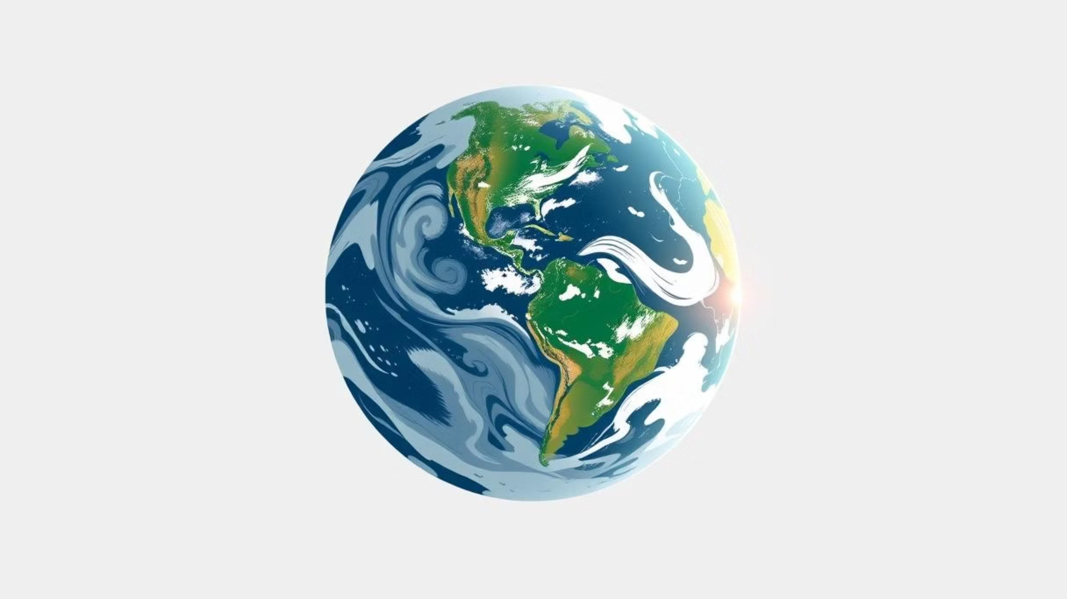
Climate Change: A Student’s Overview
Prepared by [SAIYED AQUIB] | 2025

Slide 2
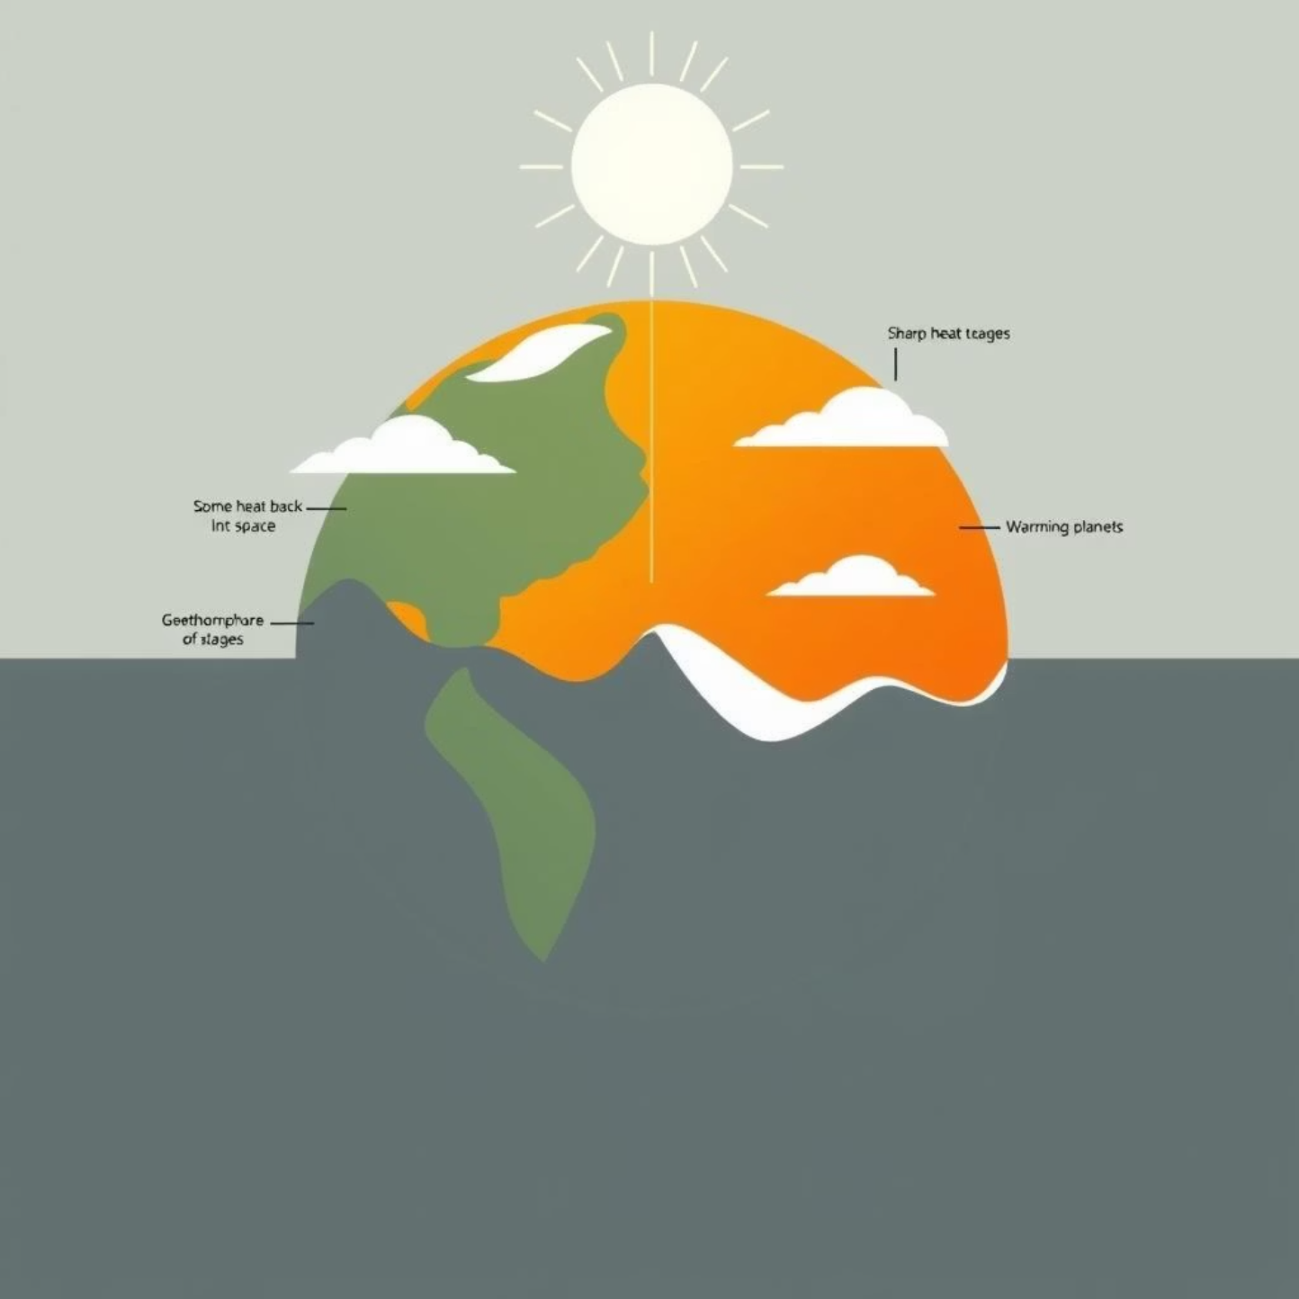
What is Climate Change?
Climate change refers to significant and long-term shifts in Earth's average weather patterns. These changes can be natural, but increasingly, they are driven by human activities.
Long-term change in Earth's average weather patterns.
Caused by both natural processes and, significantly, human factors.
Greenhouse gases, released by human activities, trap heat and warm the planet.

Slide 3
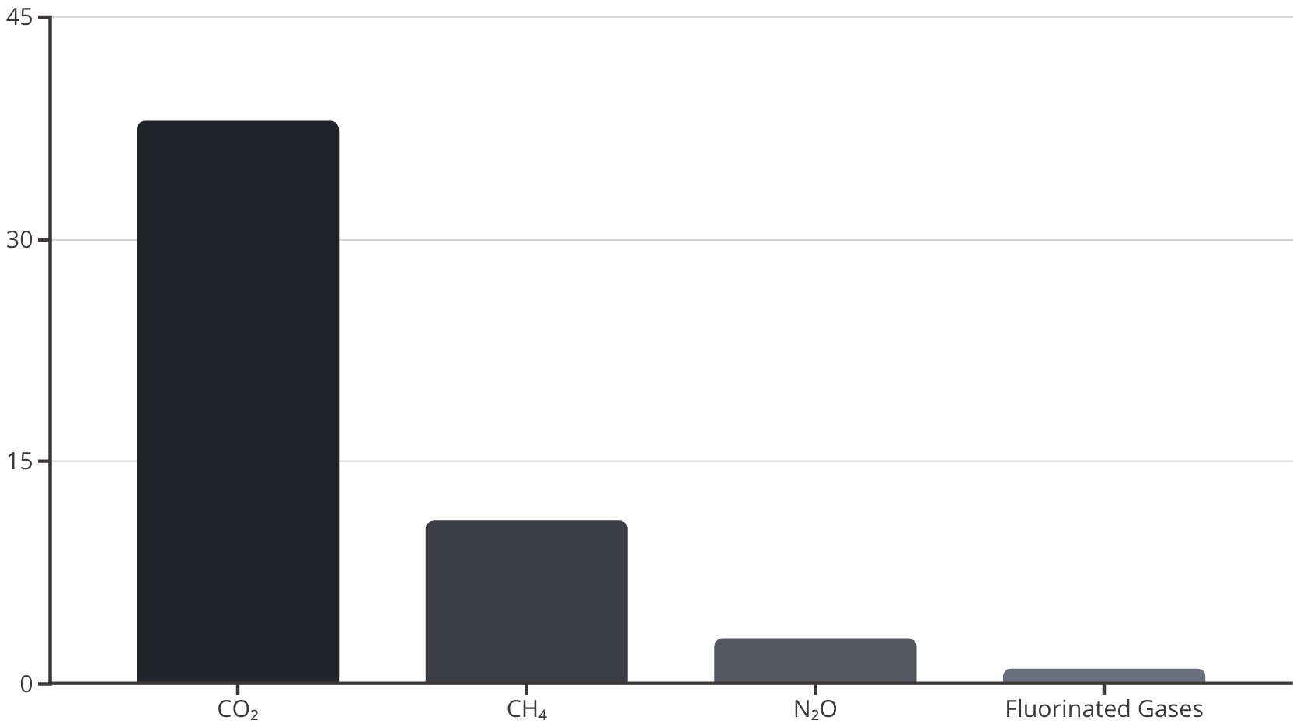
Key Greenhouse Gases & Their Impact
The primary drivers of climate change are greenhouse gases (GHGs), which absorb and emit radiant energy within the thermal infrared range, causing the greenhouse effect.
Gas
Main Sources
Heat Trapping Potential (CO₂=1)
Carbon Dioxide (CO₂)
Fossil fuels, deforestation
1
Methane (CH₄)
Agriculture, landfills, fossil fuel production
28-36
Nitrous Oxide (N₂O)
Fertilizers, industrial processes, burning fuels
265-298
Learn more about greenhouse gases and the greenhouse effect on NASA's climate site.

Slide 4
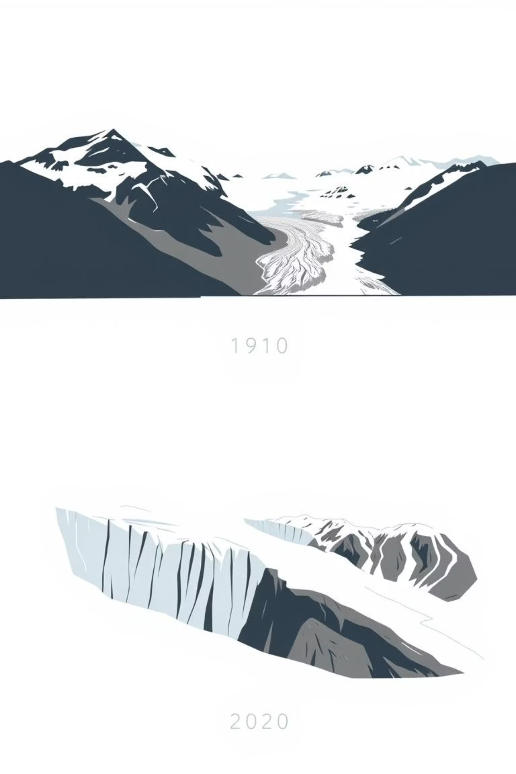




Effects of Climate Change
Rising Global Temperatures
The planet's average surface temperature has risen by approximately 1.2°C since the late 19th century.
Melting Glaciers & Sea Level Rise
Ice sheets and glaciers are rapidly shrinking, contributing to significant sea level rise and coastal erosion.
Extreme Weather Events
We are experiencing more frequent and intense heatwaves, droughts, floods, and wildfires globally.
Impact on Wildlife & Agriculture
Ecosystems are disrupted, leading to species extinction, altered crop yields, and food security challenges.

Slide 5

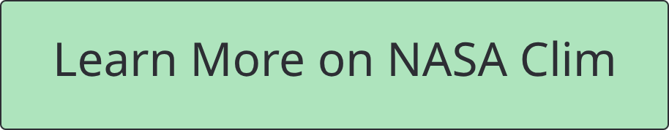
What Can We Do?
Addressing climate change requires a multi-faceted approach, from global policy changes to individual actions.
Reduce Fossil Fuel Use: Advocate for and switch to renewable energy sources like solar and wind power.
Plant Trees & Protect Forests: Reforestation and preventing deforestation are crucial for carbon sequestration.
Support Climate Policies & Education: Engage with elected officials and promote climate literacy in your community.
Personal Actions: Conserve energy, reduce waste, embrace sustainable transportation, and rethink consumption habits.

